Slide 1
Section-4 – Personalized Marketing
Chapter-9 Customer Lifetime Value

Slide 2
Introduction
In this chapter discuss the second use case of predictive analytics in marketing, the customer lifetime value.
In marketing it is always a challenge to budget for marketing campaigns.
We do not want to spend too much and result in a negative ROI.
However, we also do not want to spend too little and have no visible impact or outcome.
When determining the budget for a marketing strategy, it is essential to know what the expected return will be from running a given marketing campaign.
Understanding what the customer lifetime value (CLV) is for individual customers can help marketers justify their marketing budget, as well as target potential high-value customers.

Slide 3
Introduction
In this chapter, discuss in more detail the concept and the advantage of calculating the CLV, as well as how to build a predictive machine learning model to predict the expected CLV for individual customers in Python and R.
CLV
Evaluation metrics for regression models
Predicting the 3-month CLV with Python
Predicting the 3-month CLV with R

Slide 4
CLV
In marketing, the CLV is one of the key metrics to have and monitor.
The CLV measures customers' total worth to the business over the course of their lifetime relationship with the company.
This metric is especially important to keep track of for acquiring new customers.
It is generally more expensive to acquire new customers than to keep existing customers, so knowing the lifetime value and the costs associated with acquiring new customers is essential to build marketing strategies with a positive ROI.
For example, if the average CLV of your customer is $100 and it only costs $10 to acquire a new customer, then your business will be generating more revenue as you acquire new customers.
However, if it costs $150 to acquire a new customer and the average CLY of your customer is still $100, then you will be losing money for each acquisition.
Simply, if your marketing spend for new customer acquisition exceeds the CLV, you will be losing money for each acquisition, and it is better to just work with the existing customers.

Slide 5
CLV
There are multiple ways to calculate CLV.
One way is to find the customer's average purchase amount, purchase frequency, and lifetime span and do a simple calculation to get the CLV.
For example, think of a hypothetical case, where a customer's average purchase amount is $100 and he or she makes purchases five times every month on average.
Then this customer's average value per month is $500, which is simply multiplying the average purchase amount by the average purchase frequency.
Now, we need to know this customer's lifetime span.
One way to estimate a customer's lifetime span is to look at the average monthly churn rate, which is the percentage of customers leaving and terminating the relationship with your business.
You can estimate a customer's lifetime span by dividing one by the churn rate.

Slide 6
CLV
Assuming 5% of the churn rate in our hypothetical case, the estimated customer's lifetime span is 20 years.
Given the customer's average value per month of $500 and lifetime span of 20 years, the CLV of this customer turns out to be $120,000.
This final CLV amount is calculated by multiplying $500, the average value per month, by 12 months and the lifetime span of 20 years.
Because we do not typically know the lifetime span of customers, we often try to estimate CLV over the course of a certain period.
It can be done by estimating a customer's 12-month CLV, 24-month CLV, or can also be a 3-month CLV.
Aside from the method we discussed through an example, CLV can also be estimated through building predictive models.
Using machine learning algorithms and customers' purchase history data, build machine learning models that predict customers' CLV over the course of a certain period.
In the programming exercises in this chapter, learn how to build a regression model that predicts customers' 3-month CLV.

Slide 7
Evaluating regression models
Use a different set of metrics for evaluating regression models from those for classification model evaluations.
This is because the prediction output of a regression model takes continuous values, meaning it can take any value and is not restricted to taking from a predefined set of values.
On the other hand, in Predicting the Likelihood of Marketing Engagement, the prediction output of a classification model can only take a certain number of values.
Because of this difference, use different metrics to evaluate regression models.
In this section, discuss four commonly used methodologies to evaluate regression models mean squared error (MSE), median absolute error (MAE), R2, and predicted versus actual scatter plot.

Slide 8


Evaluating regression models
As the name suggests, MSE measures the average of the squared errors, where the errors are the differences between the predicted and actual values.
The equation for MSE looks as follows:
The Y values in this equation are the actual values and Y' values are the predicted values.
Because MSE is an average of squared errors, this measure is sensitive to and highly affected by outliers.
The MAE, on the other hand, is less sensitive to outliers and considered more robust, as the median is affected by the outliers or values at the end tails much less than the average.
The equation, looks as follows:
The y values in this equation represent the actual values and the ŷ values represent the predicted values.

Slide 9

Evaluating regression models
Another frequently used measure for regression models is R², also called the coefficient of determination.
R² measures the goodness of fit.
In other words, it measures how well a regression model is fitted to the data.
Simply, R² is the percentage of the explained variability of the target variable by the regression model.
The equation looks as follows:
R² typically ranges between zero and one.
The R² value of zero means the model does not explain or capture the target variable variability at all and is not a good fit for the data.
On the other hand, the R² value of one means that the model captures 100% of the target variable variability and is a perfect fit to the data.
The closer to one the R² value is, the better the model fit is.

Slide 10
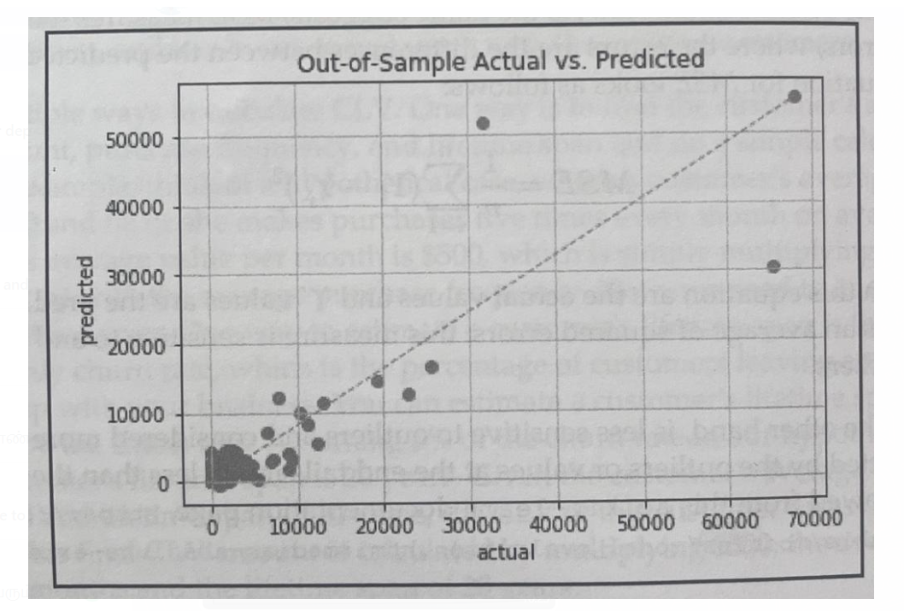
Evaluating regression models
Lastly, a scatter plot of predicted values against actual values is also used to visualize how closely the model fits.
An example of this scatter plot looks like the following:
For a good fit, points in this scatter plot that are close to the diagonal line.
If the model's R² is high, the points will be close to the diagonal line.
On the other hand, if the model's R² is low, the points will be dispersed away from the diagonal line.
In the following programming exercises, how to compute and visualize these measures in Python and R, and will use these measures to evaluate our regression model.

Slide 11
Predicting the 3 month CLV with Python
In this section, discuss how to build and evaluate regression models using machine learning algorithms in Python.
By the end of this section, build a predictive model using a linear regression algorithm to predict the CLV, more specifically, the expected 3-month customer value.
Use the pandas, matplotlib, and scikit-learn packages to analyze, visualize, and build machine learning models that predict the expected 3-month customer value.
For this exercise, use one of the publicly available datasets from the UCI Machine Learning Repository, which can be found at this link: ht tp://archive. ics.uci. edu/ml/datasets/online+retail.
Download the data that is available in XLSX format, named Online Retail. xlsx.
Once downloaded this data, load it into your Jupyter Notebook by running the following command:
import pandas as pd
df = pd. read_excel ('../data/Online Retail xlsx', sheet_name=' OnlineRetail’ )

Slide 12
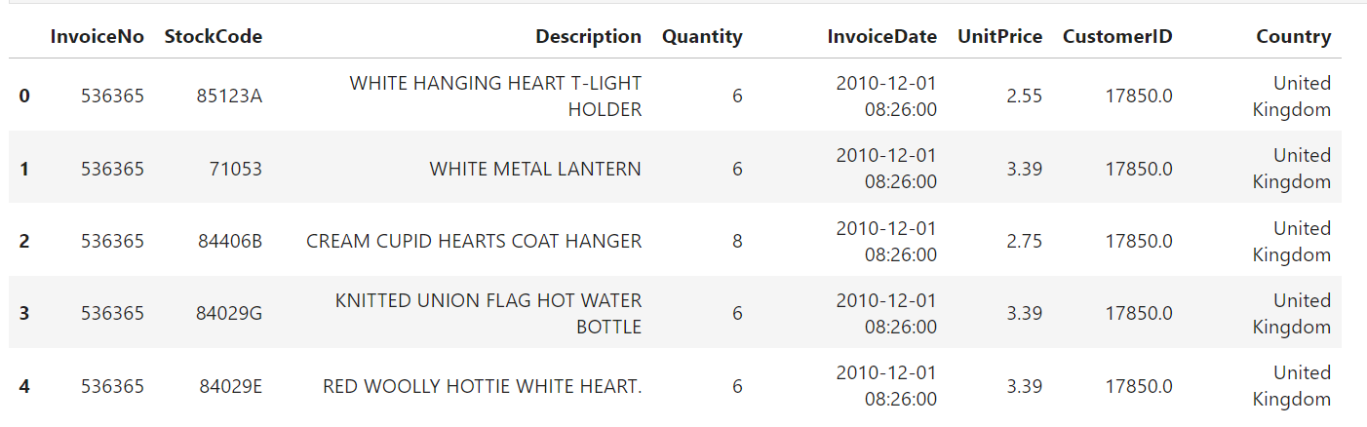
Predicting the 3 month CLV with Python
The DataFrame, df, looks as follows:
We have used this dataset a few times in the previous chapters.
With the knowledge gained about this dataset from the previous chapters, first prepare our data by cleaning it up.

Slide 13
Data cleanup
There are a few things we need to clean up in this dataset.
The clean-up steps are as follows:
1. Handling negative quantity: There are transactions with a negative Quantity value, which represent canceled orders.
Ignore those canceled orders for this exercise, so exclude them from our pandas DataFrame.
The code to exclude these negative values in the Quantity column looks as follows:
df = df. loc[df [ 'Quantity'] > 0]
Simply take all of those rows with a positive Quantity value and store them back to the df variable.

Slide 14
Data cleanup
2. Dropping NaN records: Drop records with no Customer ID.
Since we are going to build a machine learning model to predict the 3-month customer value, group the data by the Customer ID column.
Without it, cannot properly build models for this project.
The code to drop records with no Customer ID values looks like the following code snippet:
df = df [pd. notnull (df [ 'CustomerID’])]
Use the notnull function in the pandas package to drop those observations.
This function returns a list of arrays, where True values indicate that the value in the given index is not null, and False values indicate that the value in the given index is null.
Store these records with not null values in the Customer ID column back to the df variable.

Slide 15
Data cleanup
3. Handling incomplete data: Another cleanup is to handle incomplete data.
If you recall from previous chapters, the transaction data for the last month is incomplete.
Take a look at the following output:
print('Date Range: 8s - 8s' & (df[ 'InvoiceDate’].min(), df[ 'InvoiceDate’ ].max ()) )
Date Range: 2010-12-01 08:26:00 - 2011-12-09 12:50:00
It is observed from this output, that the dataset has all of the transactions between December 1, 2010 and December 9, 2011.
The data for the last month, December 2011, is not complete.
To properly build a model for the 3-month customer value predictions, ignore the transactions in the last month.
Take a look at the following code that shows how to drop those records from our DataFrame:
df = df. loc[df ['InvoiceDate'] < '2011-12-01’]
Simply taking all of the transactions that occurred before December 01, 2011 and storing them back to the df variable.

Slide 16
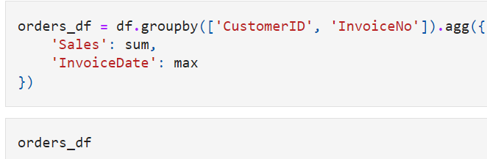
Data cleanup
4. Total sales value: Lastly, we need to create a column for the total sales value for each transaction.
Take a look at the following code:
df ('Sales'] = df['Quantity'] * df['UnitPrice’]
Multiplying the Quantity column by the UnitPrice column to get the total purchase amount for each transaction.
Then, store these values in a column named Sales.
Now we completed all of the clean-up tasks.
let's summarize this data for each order or InvoiceNo.
Take a look at the following code which groups the DataFrame df by two columns, CustomerID and InvoiceNo.
Then, sum up all of the sales values for each customer and order, and take the last transaction time for the given order as InvoiceDate.

Slide 17
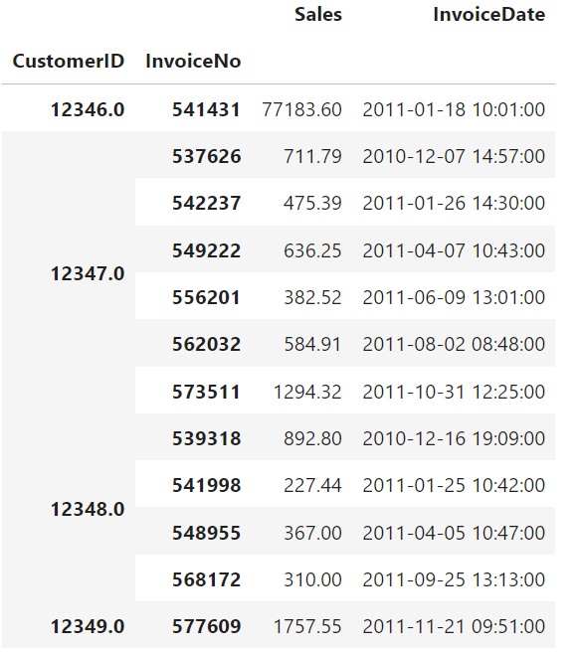
Data cleanup
orders_df, is useful to know about each order that each customer placed.
The data looks like the following:

Slide 18
Data analysis
To calculate the CLV, know the frequency, recency, and total amount of purchases by each customer.
Compute basic information about each customer's average and lifetime purchase amount, as well as each customer's duration and frequency of purchases.
Take a look at the following code:
First group by the Customer ID column and aggregate the numbers by Sales and InvoiceDate columns.
Use four customer aggregation functions: groupby_mean, groupby_count, purchase_duration, and avg_frequency.
The first function, groupby_mean, simply computes the average for each group and the second function, groupby_count, simply counts the number of records in each group.
The purchase_duration function counts the number of days between the first and last invoice dates in each group and the avg_frequency function calculates the average number of days between orders by dividing purchase_duration by the number of orders.

Slide 19
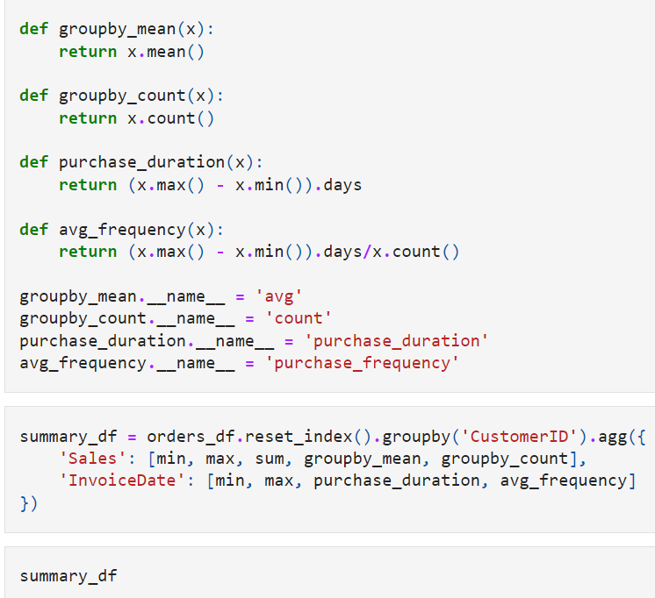
Data analysis

Slide 20
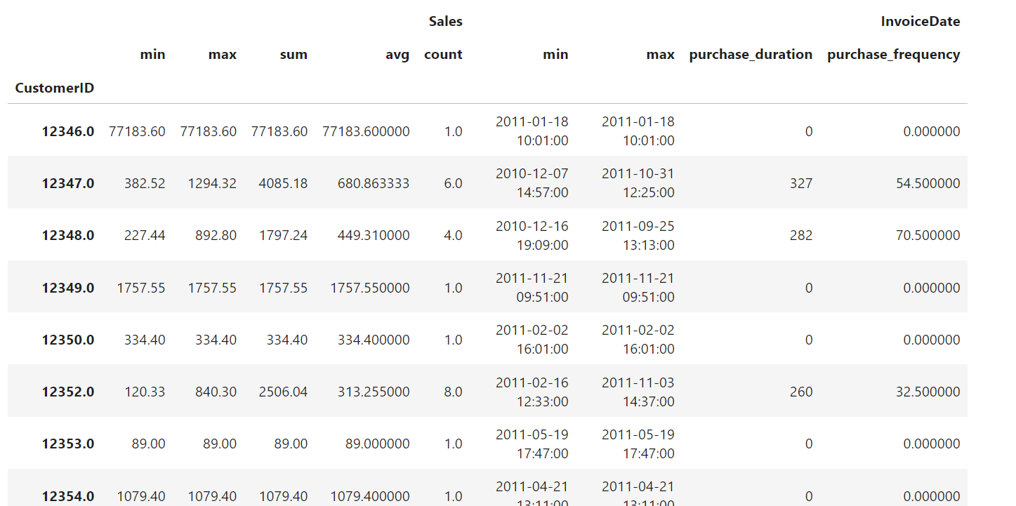
Data analysis

Slide 21
Data analysis
This data gives us an idea of the purchases each customer has made.
For example, the customer with ID 12346 only made one purchase on January 18, 2011.
However, the customer with ID 12347 has made six purchases that range from December 7, 2010 to October 31, 2011, or over the course of 327 days.
The average amount this customer spent on each order is 680 and, on average, this customer made a purchase every 54.5 days.
Let's take a closer look at the distributions of the number of purchases that the repeat customers have made.
Take a look at the following code:

Slide 22
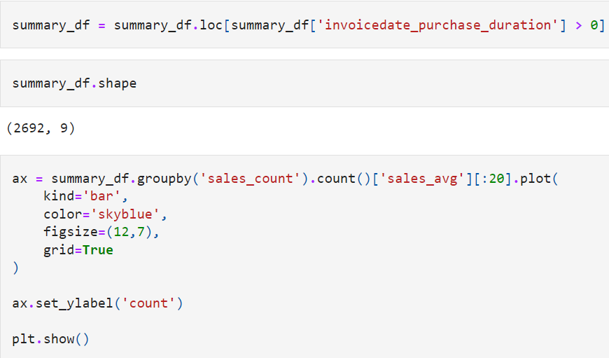
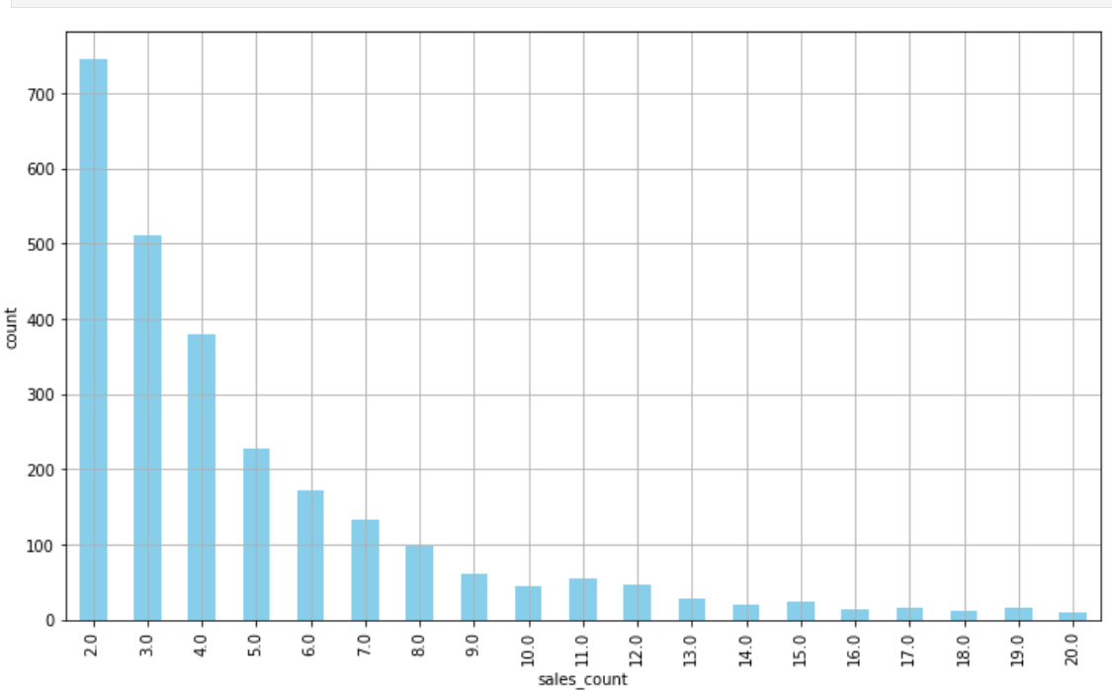
Data analysis

Slide 23
Data analysis
From this code, clean up the column names of the DataFrame, summary_af, in the first line.
Then, only take the customers who have made at least two or more purchases, which represents repeat customers.
Lastly, group by the sales_count column and count how many customers belong to each category.
From this plot, the majority of customers have made 10 or fewer purchases historically.
Let's take a look at the average number of days between purchases for these repeat customers.
Building a histogram with the purchase frequency data using the hist function in the pandas package.
The bins parameter defines the number of histogram bins to build.
The plot tells us the overall view of how frequently repeat customers made purchases historically.
The majority of repeat customers made purchases every 20 to 50 days.

Slide 24
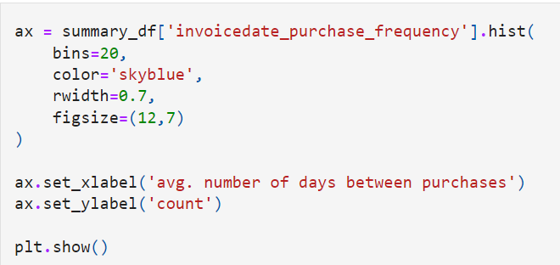
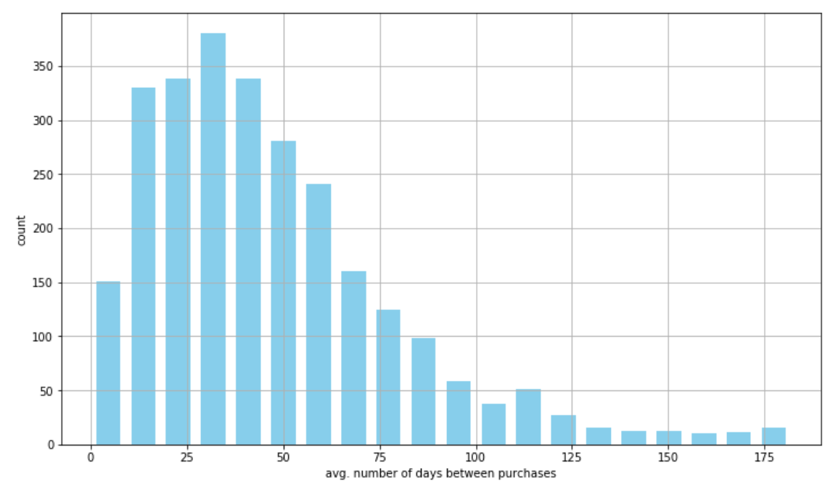
Data analysis

Slide 25
Predicting the 3-month CLV
In this section, build a model that predicts the 3-month customer value using the pandas and scikit-learn packages in Python.
First slice the data into chunks of 3 months and take the last 3 months’ data as the target for predictions and the rest as the features.
First prepare our data for model building and then train a linear regression model for the 3-month customer value predictions.

Slide 26
Data preparation
To build a predictive model, prepare our data first with the following code so that feed the relevant data into the model.
To predict the 3-month customer value, breaking down the data into chunks of 3 months for each customer.
Group the previously built DataFrame orders_df by Customer ID and a custom Grouper, which groups InvoiceDate every 3 months.
Then, for each group of 3-month time windows, sum up all of the sales to get the total purchase amount, and take the average purchase amount and the total number of purchases for the given period for each customer.
This way we have aggregate data that has purchase information for each customer for every 3 months.
Lastly, do some cleanup for the column names.
The data in data_df now looks like the following:

Slide 27
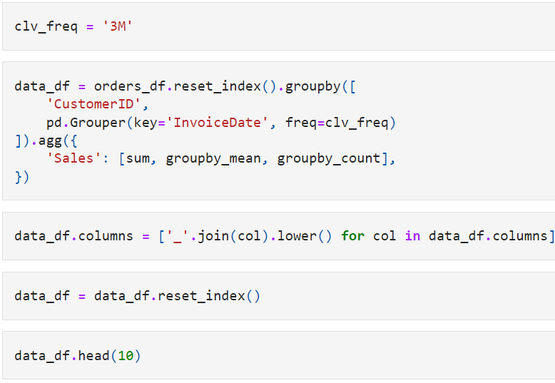
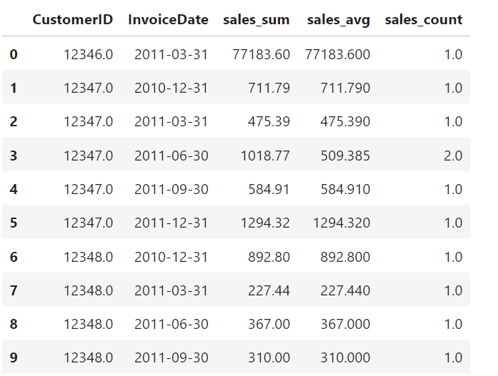
Data preparation

Slide 28
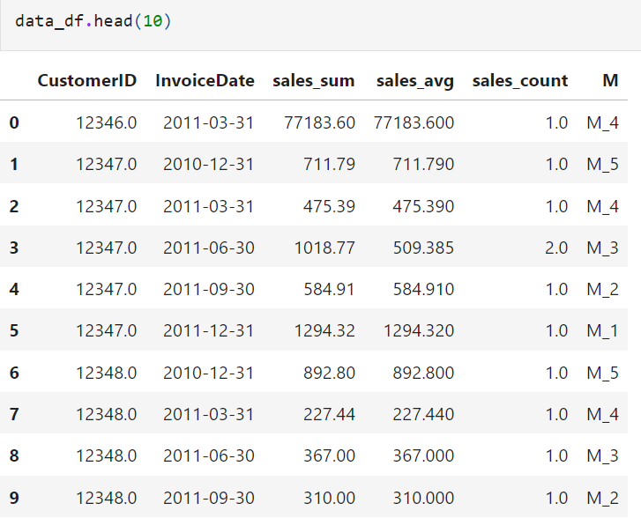
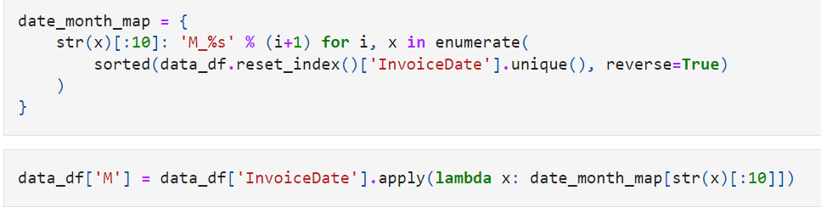
Data preparation
To make things simpler, let's encode the InvoiceDate column values
so that they are easier to read than the current date format.
Take a look at the following code:

Slide 29
Data preparation
Encoding date values into M_1, M_2, M_3, and so forth, where the smaller number represents more recent dates.
For example, the date 2011-12-31 is now encoded as M_1 and the date 2011-09-30 is now encoded as M_2.
Now ready to build a sample set with features and target variables.
As briefly mentioned before, use the last 3 months as the target variable and the rest as the features
Train a machine learning model that predicts the last 3 months' customer value with the rest of the data.
To train such a model, transform this data into tabular data, where the rows represent the individual customers and the columns represent each feature.
Take a look at the following code:

Slide 30
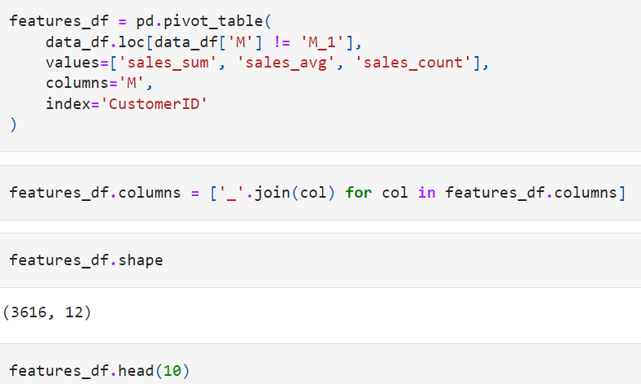
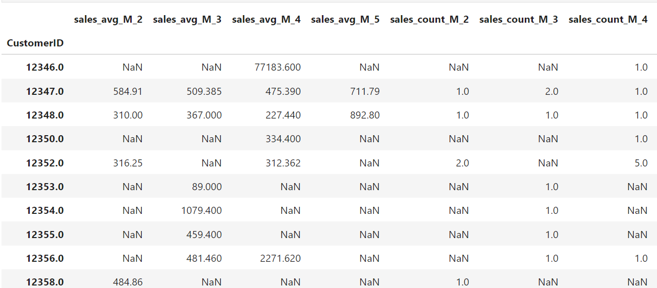
Data preparation

Slide 31
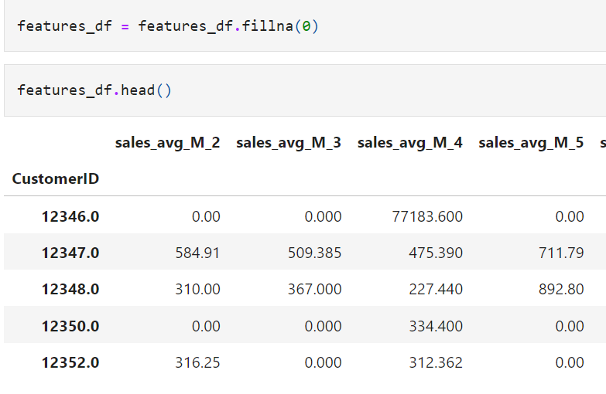
Data preparation
You might notice that this data has NaN values.
We can encode these NaN values with 0.0 using the following code:

Slide 32
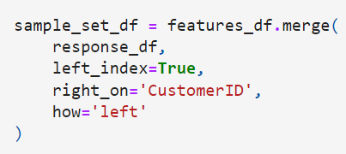
Data preparation
Taking the last 3-month period, the M_1 group, as the target variable.
The target column will be sales_sum, to predict the next 3-month customer value, which is the total purchase amount that a given customer is likely to make in the next 3 months.
The target variable looks like the following:
There is only one thing left to build, which is a sample set for building machine learning models, combining features and response data together.
Take a look at the following code:

Slide 33
Data preparation
Simply join the two DataFrames on Customer ID, using the merge function
By having the how=' left ' flag, take all records in the features data, even if there is no corresponding data in the response data.
This is a case where the given customer did not make any purchases in the last 3 months, so encode them as zero.
The final sample set now looks as follows:

Slide 34
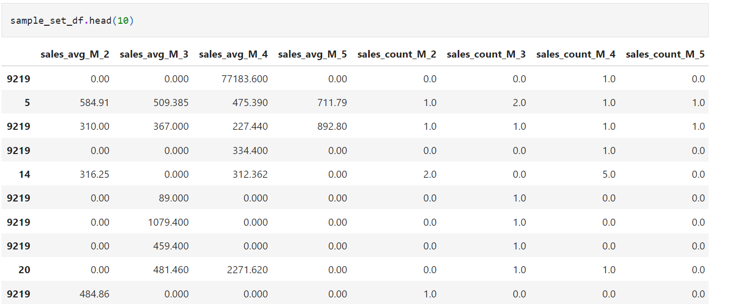
Data preparation
With this data, build a model that predicts the next 3 month customer value with historical purchase data.

Slide 35
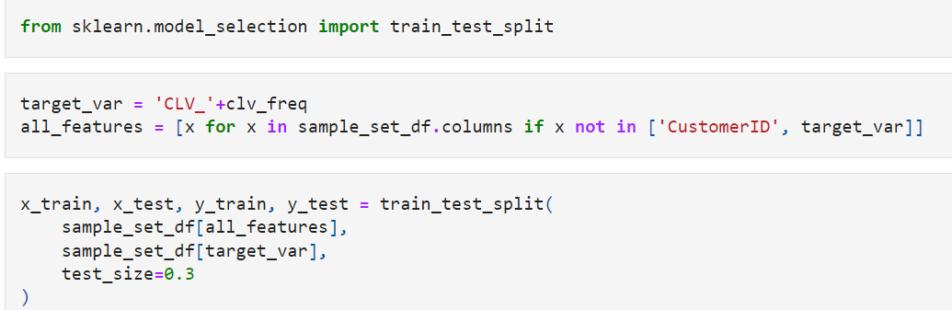
Linear regression
Split the sample set into train and test sets, using the following code:
Taking 70% of the sample set for training the model and the remaining 30% for testing and evaluating the model performance.

Slide 36
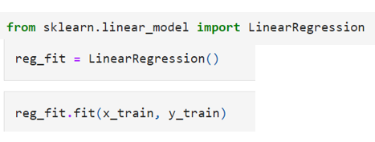
Linear regression
To train a linear regression model with our dataset, use the following code:
Import the LinearRegression class of the scikit-learn package and initiate a LinearRegression object.
Then, train a linear regression model using the fit function with the x_train features and the y_train targets.
Once a linear regression model is trained, there is some useful information can find in the LinearRegression object

Slide 37
Linear regression
First, get the intercept of the linear regression equation, using the intercept_ attribute of the LinearRegression object
Also, find the fitted linear regression model's coefficients, using the coef_ attribute
From the coefficient output, easily find which features have a negative correlation with the target and which features have a positive correlation with the target.
For example, the previous 3-month period's average purchase amount, sales_avg_M_2, has negative impacts on the next 3-month customer value.
This means that the higher the previous 3-month period's purchase amount is, the lower the next 3-month purchase amount will be.
On the other hand, the second and third most recent 3-month period's average purchase amounts, sales_avg_M_3 and sales_avg_M_4, are positively correlated with the next 3-month customer value.
In other words, the more a customer made purchases 3 months to 9 months ago, the higher value he or she will bring in the next 3 months.
Looking at the coefficients is one way to gain insights into how the expected value will change, given certain features.

Slide 38
Linear regression
Using the 3 month customer value prediction output, can custom-tailor your marketing strategies in different ways.
Since you know the expected revenue or purchase amount from individual customers for the next 3 months, you can set a better-informed budget for your marketing campaign.
It should be set high enough to reach your target customers, but low enough to be below the expected 3-month customer value, so that you can have a positive ROI marketing campaign.
On the other hand, use these 3-month customer value prediction output values to specifically target these high-value customers for the next 3 months.
This can help to create marketing campaigns with a higher ROI, as those high-value customers, predicted by this model, are likely to bring in more revenue than the others.

Slide 39
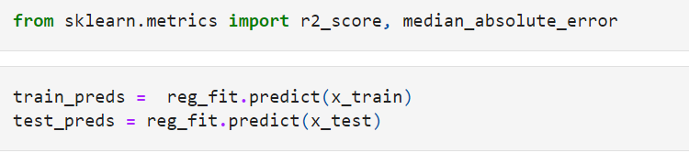
Evaluating regression model performance
Now a machine learning model that is fitted to predict the 3-month customer value.
Now let's discuss how to evaluate the performance of this model.
As discussed previously, use R2, MAE, and a scatter plot of predicted versus actual to evaluate our model.
First, get the prediction output from our model as shown in the following code
The scikit-learn package has implemented the functions to compute the R2 and the MAE in their metrics module, use these functions by importing them into your environment

Slide 40
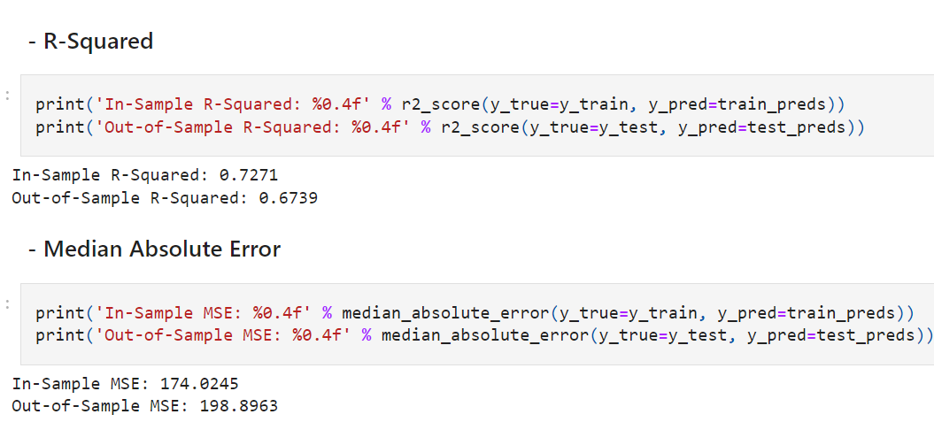
Evaluating regression model performance
Both functions take two parameters, y_true and y_pred.
The y_true parameter is for the actual target values and the y_pred parameter is for the predicted target values.
Using these codes, the in-sample and out-of-sample values for R2 and MAE in our case looks like the following output:

Slide 41
Evaluating regression model performance
Due to the randomness in splitting the sample set into train and test sets, might differ from these results.
In our case, the in-sample R2 was 0. 4445, and the out-of-sample R2 was 0.7947.
On the other hand, the in-sample MAE was 178. 2854 and the out-of-sample MAE was 178. 7393.
Looking at these numbers, we do not necessarily see a hint of overfitting or a big gap between the in-sample and out-of-sample performances.
Lastly, let's take a look at the scatter plot of predicted versus actual.

Slide 42
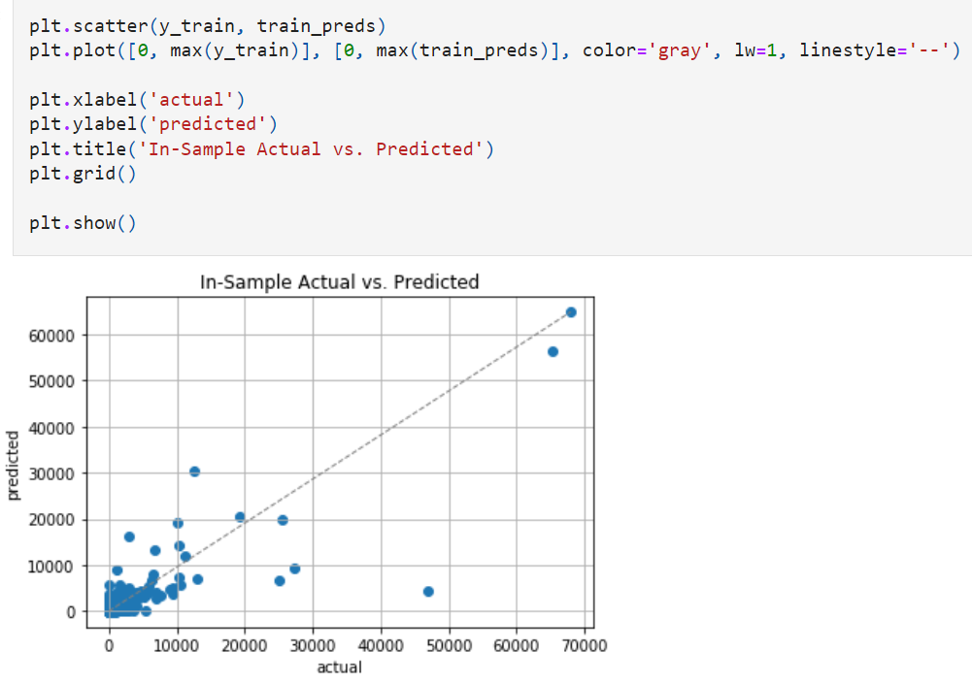
Evaluating regression model performance

Slide 43
Evaluating regression model performance
From this plot, the x-values are the actual values and the y-values are the predicted values.
As discussed earlier, the more the points that are on the straight line, the better the predictions are.
This is because points on the straight line suggest that the actual values and the predicted values are close to each other.
Looking at this plot, the points seem to be positioned around a straight line, which suggests that the predictions and the actual values are not too far apart from each other.

Slide 44
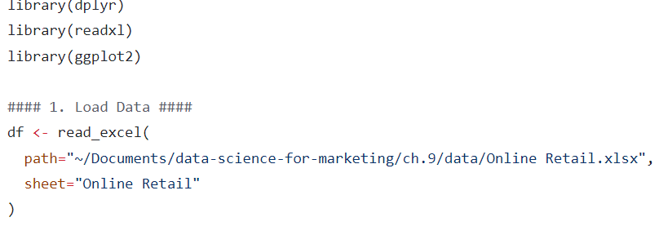
Predicting the 3 month CLV with R

Slide 45
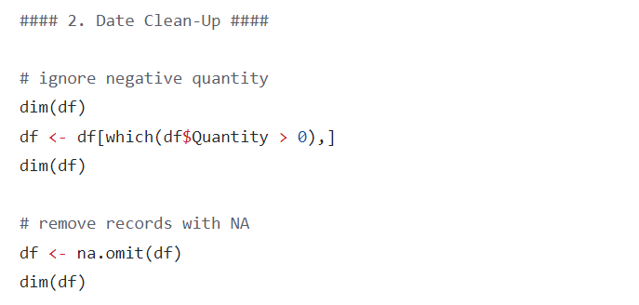
Predicting the 3 month CLV with R

Slide 46
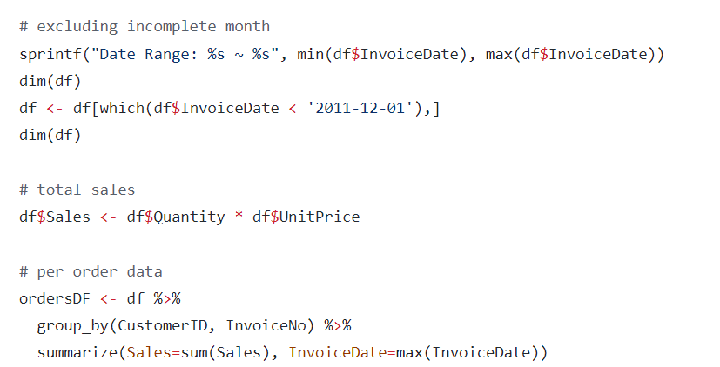
Predicting the 3 month CLV with R

Slide 47
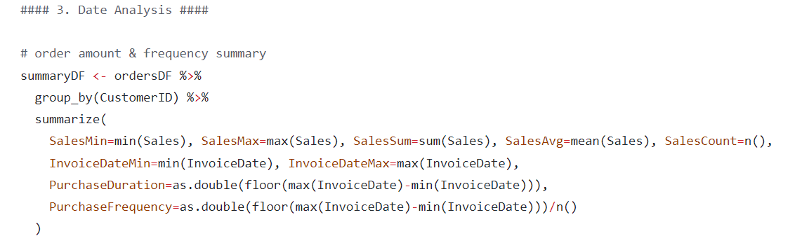
Predicting the 3 month CLV with R

Slide 48
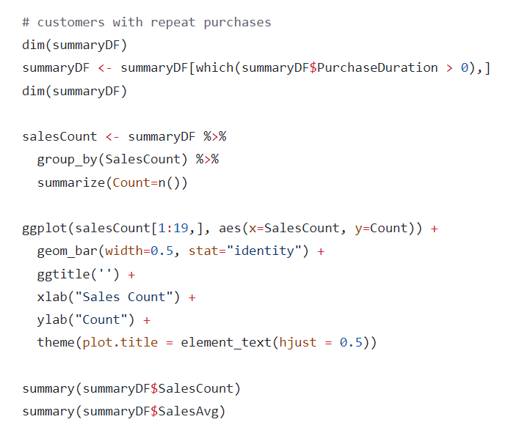
Predicting the 3 month CLV with R

Slide 49
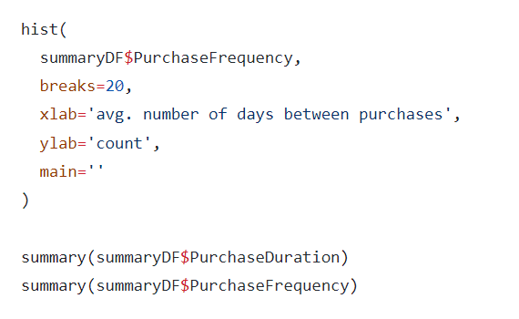
Predicting the 3 month CLV with R

Slide 50
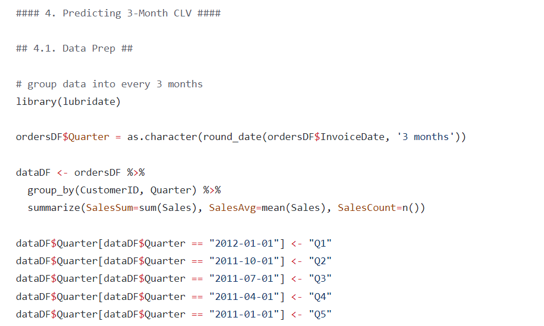
Predicting the 3 month CLV with R

Slide 51
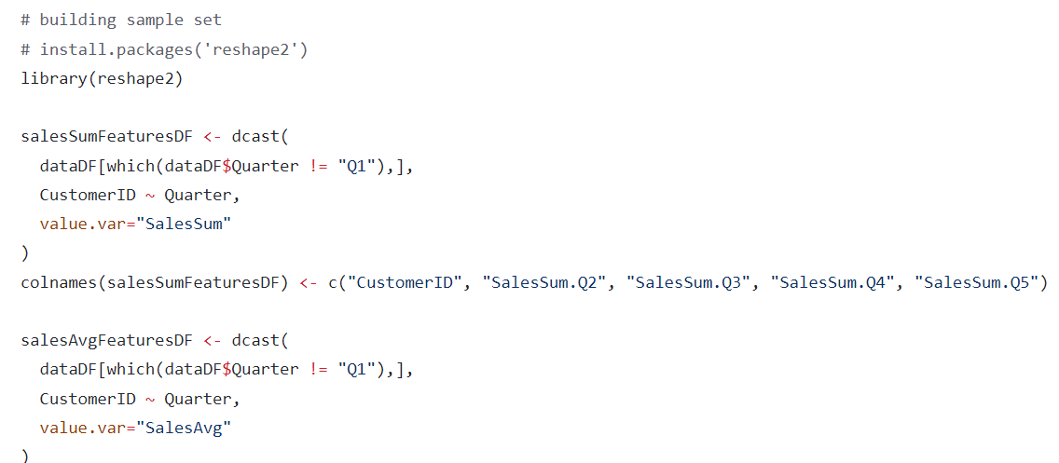
Predicting the 3 month CLV with R

Slide 52
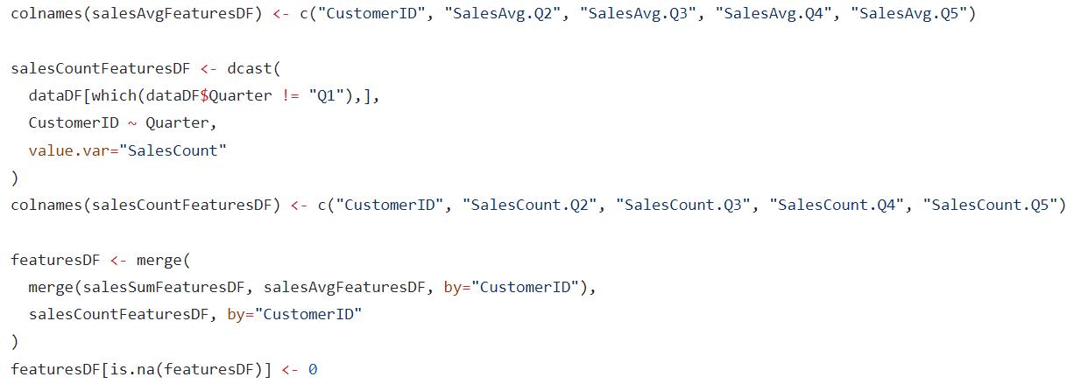
Predicting the 3 month CLV with R

Slide 53
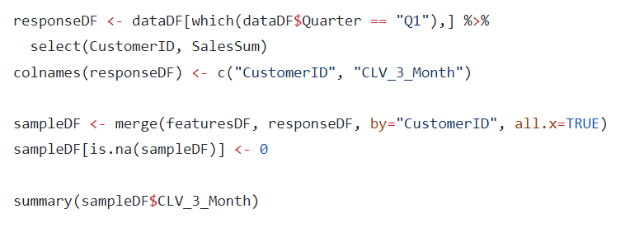
Predicting the 3 month CLV with R

Slide 54
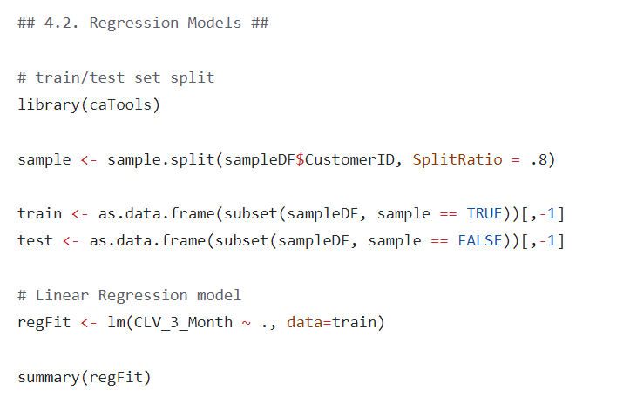
Predicting the 3 month CLV with R

Slide 55
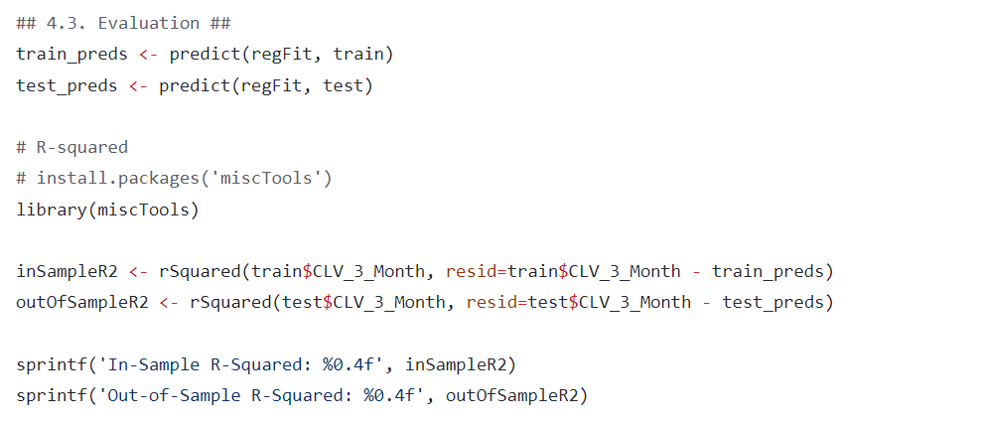
Predicting the 3 month CLV with R

Slide 56
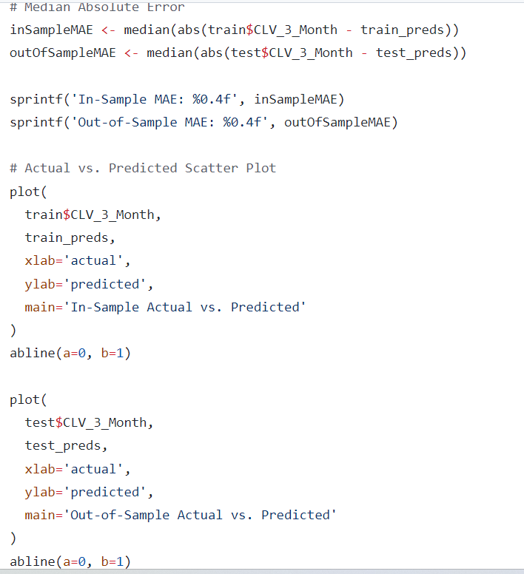
Predicting the 3 month CLV with R

